Slide 1
Before we get started… why are you here? https://b.socrative.com/login/student/ Room: JLO

Slide 2
Learning Events and Learning Record Stores: A Practical Introduction

Slide 3
More Socrative Questions! https://b.socrative.com/login/student/ Room: JLO

Slide 4
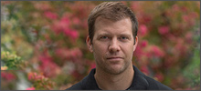
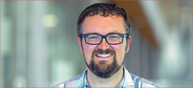
I’m talking, but this is the work of many people
Craig Thompson
Research Analyst
Justin Lee
Programmer Analyst
Sung Hwang
Systems Analyst
Andrew Gardener
Programmer Analyst Former Team Member
Scott McMillan
Systems Analyst Former Team Member
Jeff Longland
Lead / Solutions Architect

Slide 5
Drinking from the firehose
Who needs learning events?
Who is a learning event about?
What is a learning event?
When does a learning event occur?
Where do learning events occur?
Where do they go?
Why?
“Drinking from the Firehose of Education”
https://www.flickr.com/photos/namlhots/5473256613

Slide 6
Principles for Learning Analytics at UBC
Respect for persons
Learners as autonomous agents
Responsibility
Equity
Stewardship and privacy
Accountability and transparency
Evolving and dynamic

Slide 7
Building a solution for learning data
UBC’s first learning record store launched in 2014
Learning Analytics Project 2017-2020
Develop, pilot, evaluate and support data-informed learning technology
Explore cloud architectures for learning data
Instrument UBC tools to collect and emit learning events
Consume learning events from vendor tools
Why build our own solution in the cloud?
High degree of control (e.g. consume both xAPI and Caliper events)
Ability to align with our LA principles
Why the cloud?
Modern tooling (ex. infrastructure as code)
Managed services and serverless
Streaming data

Slide 8
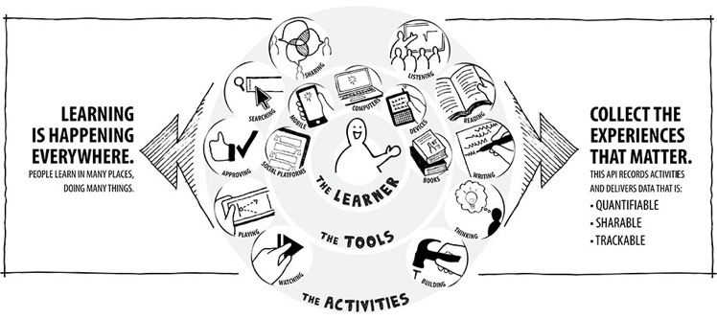
http://experienceapi.com/overview/

Slide 9
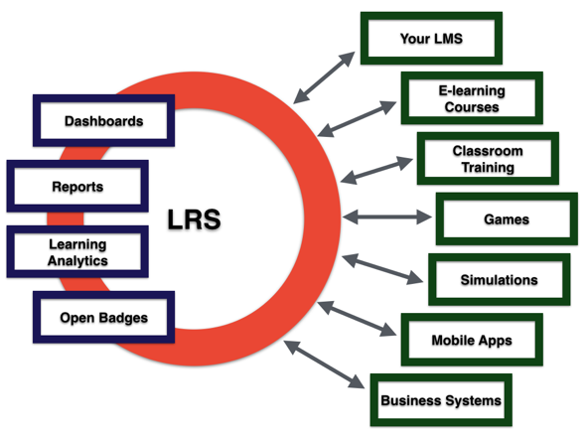
http://experienceapi.com/ecosystem/

Slide 10
http://images.slideplayer.com/15/4703506/slides/slide_42.jpg

Slide 11
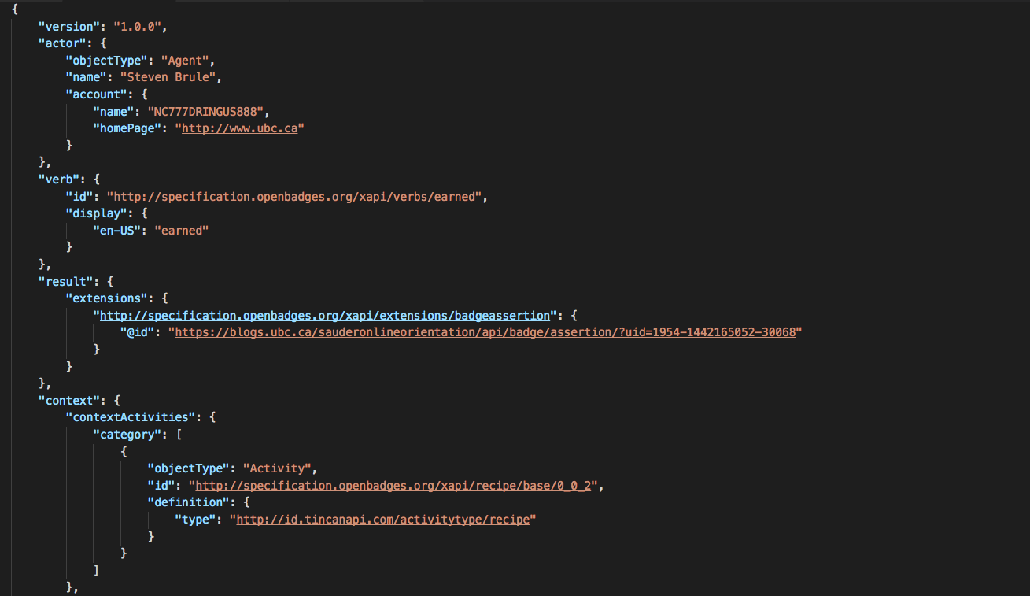

Slide 12
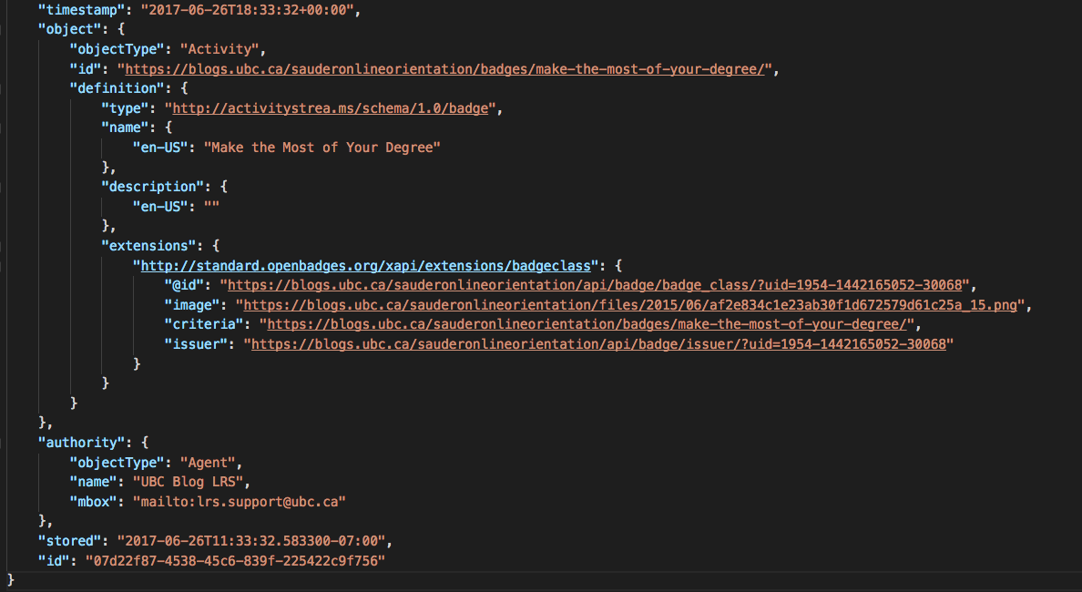

Slide 13
Caliper event model

Slide 14
Caliper event model
Caliper metric profiles

Slide 15
Caliper event model
Caliper metric profiles
CALIPER FORUM PROFILE

Slide 16
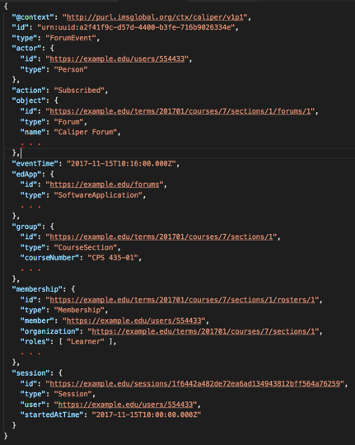

Slide 17
UBC’s approach for learning events
Preference for Caliper over xAPI
More structured
Established community and processes for contributing to the specification
Sensors generally well-maintained alongside specification releases
https://www.imsglobal.org/activity/caliper
https://github.com/IMSGlobal?q=caliper
Andrew Gardener did a lot of work in this area
Instrumented ComPAIR, iPeer, UBC Blogs, UBC Wiki, and WeBWork
Active contributor to the Caliper 1.2 specification and sensors
Received an IMS Higher Education Leadership Award in 2019 for his work

Slide 18
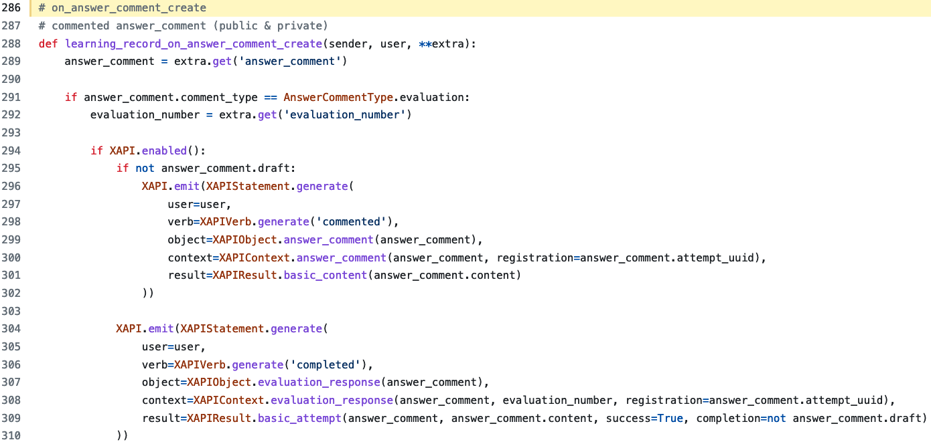

Slide 20
Events go to Our learning record store
Built on AWS using serverless and streaming data services
~2500 lines of CloudFormation YAML that define the LRS
Lambdas are written in Node.js
Intent is to release under an open source license
Acknowledgements
Scott McMillan was the initial author and deserves acknowledgement for the many headaches he endured while defining an API Gateway in CloudFormation.
Sung Hwang and Justin Lee have continued work, notably improving performance and capturing events that fail to process.

Slide 21
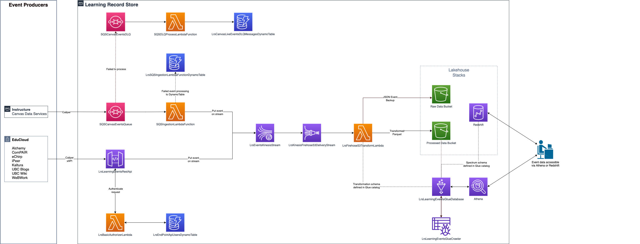

Slide 22
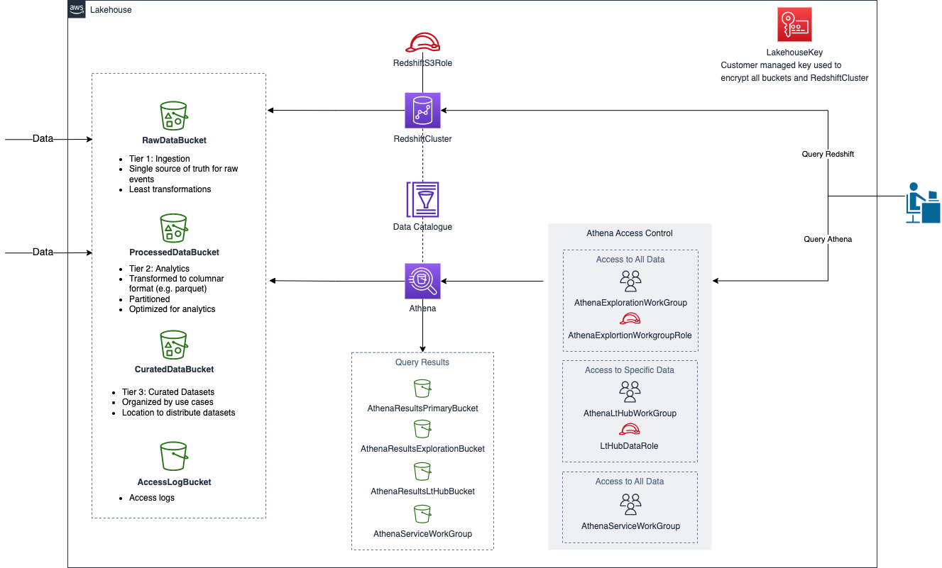

Slide 23
id | urn:uuid:6150ecad-36c6-4629-9a76-0df60228e7be
type | AssignableEvent
action | submitted
event_time | 2023-01-22T10:47:03.310Z
ed_app | http://canvas.ubc.ca/
course_offering_id | 11111000000022222
actor_id | urn:instructure:canvas:user:111110000000555555
session_id | Null
statement_type | caliper
statement_version | http://purl.imsglobal.org/ctx/caliper/v1p1
event | {"@context":"http://purl.imsglobal.org/ctx/caliper/v1p1","id":"urn:uuid:6150ecad-36c6-4629-9a76-0df60228e7be","type":"AssignableEvent",
object_id | urn:instructure:canvas:submission:112240000110123456
udm_course_offering_id | Null
udm_actor_id | Null
membership_id | urn:instructure:canvas:course:11111000000022222:user:111110000000555555
membership_type | Membership
membership_organization | urn:instructure:canvas:course:11111000000022222
membership_role | Null
membership_status | Null
membership_date_created | Null
group_id | urn:instructure:canvas:course:11111000000022222
group_type | CourseOffering

Slide 24
How’s it going? https://b.socrative.com/login/student/ Room: JLO

Slide 25
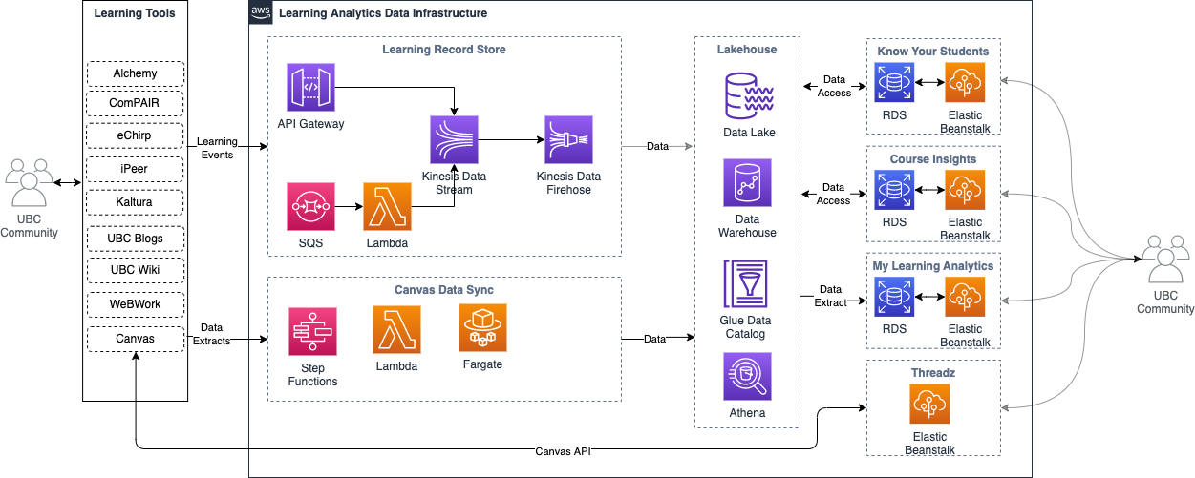
UBC’s learning data infrastructure

Slide 26
My Learning analytics
Student Dashboard
Python, Django, React, MySQL
https://github.com/tl-its-umich-edu/my-learning-analytics/

Slide 27
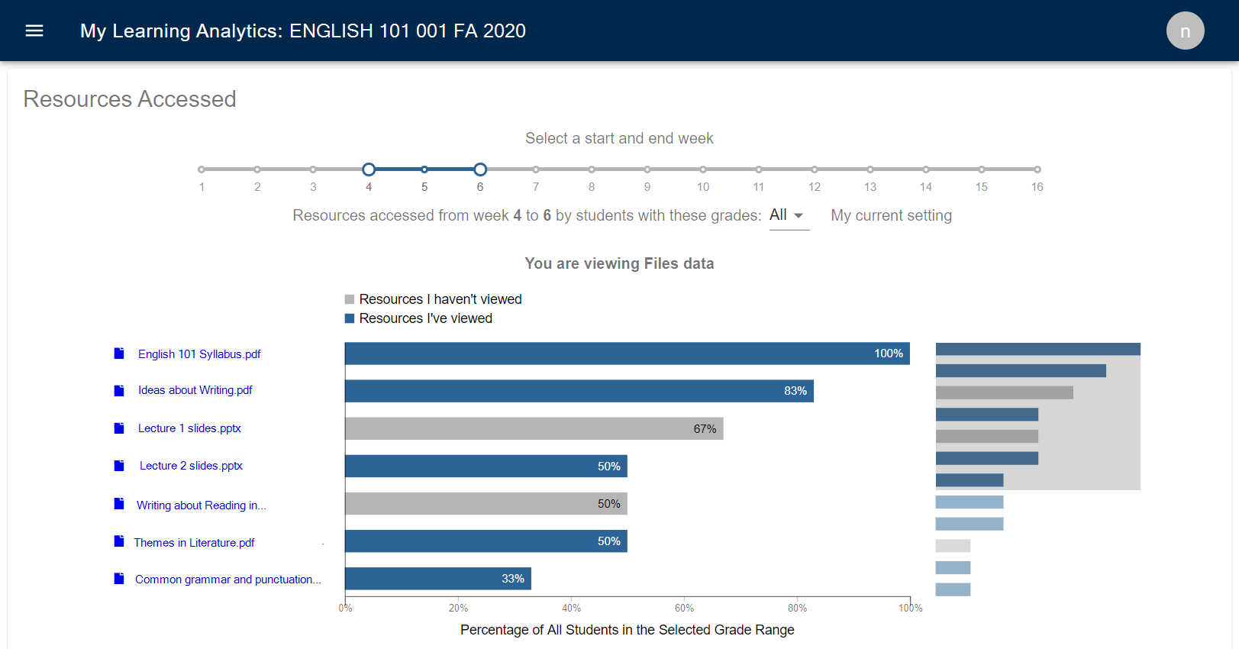

Slide 28
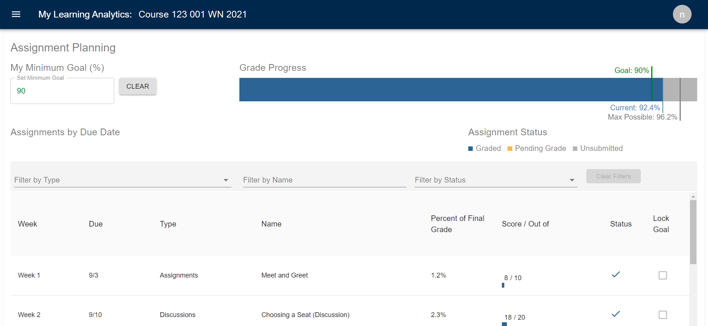

Slide 30
Course insights
Instructor Dashboard
Python, Django, React, PostgreSQL

Slide 31
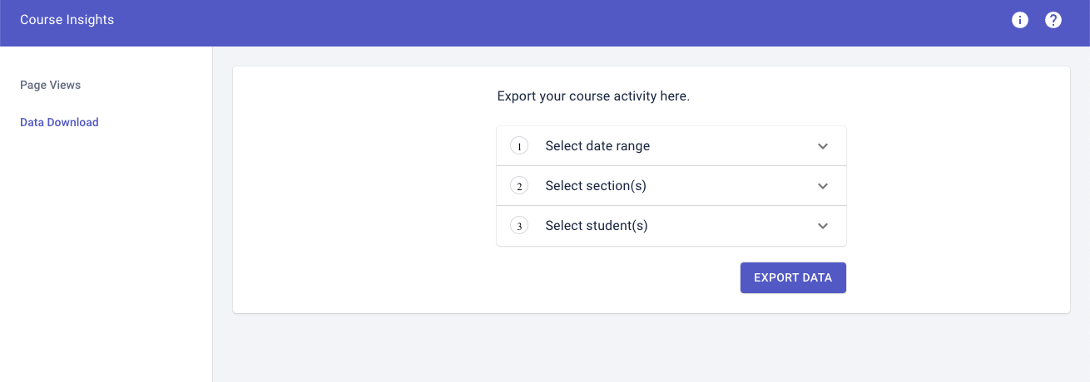

Slide 32
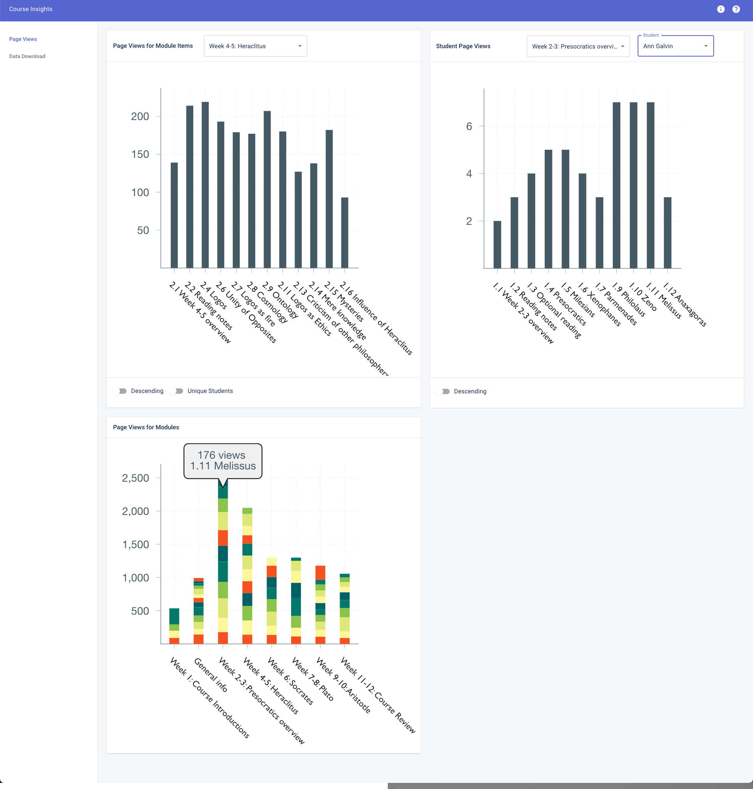

Slide 33
Problems with learning event data!
A lack of attention to learning ecosystems
A lack of consistent data policies and practices
Poor implementations of standards
Competing standards
Attempts to treat learning data as a unique competitive advantage hurt us all
Creating Data for Learning Analytics Ecosystems (Kitto, Whitmer, Silvers, Webb)

Slide 34
What’s next for the lrs?
Build an access framework
Build curated data sets for dashboards, reports and tools
Instrument additional tools and refine existing tools
Work with vendors to provide data
Work through a myriad of inevitable and unavoidable data issues
Actually leveraging the real-time stream
Open source! Plus our other projects:
VPC, Lakehouse
Canvas Data Sync
Course Insights

Slide 35
The last slide, in the last time slot of the day… https://b.socrative.com/login/student/ Room: JLO

Slide 36
jeff.longland@ubc.ca UBC Learning Technology Hub

